Slide 1
NIGERIA’S EMERGING THREAT LANDSCAPE: TACKLING INSECURITY CHALLENGES WITH INNOVATION
Engr. R. Tombari Sibe

Slide 2
INTRODUCTION
Growing insecurity
Increasing Threat Actors
Porous Borders
High caseloads
Low technology adoption
Socioeconomic Factors
Gaps in law enforment

Slide 3
GLOBAL SECURITY LANDSCAPE
Cybersecurity Threats
Global Pandemic
Global Arms Movement (proliferation of light arms)
Emerging technologies
Religious Extremism
Arsonist/Sabotage – Oil pipeline vandals
Piracy, armed robbery, etc.

Slide 4
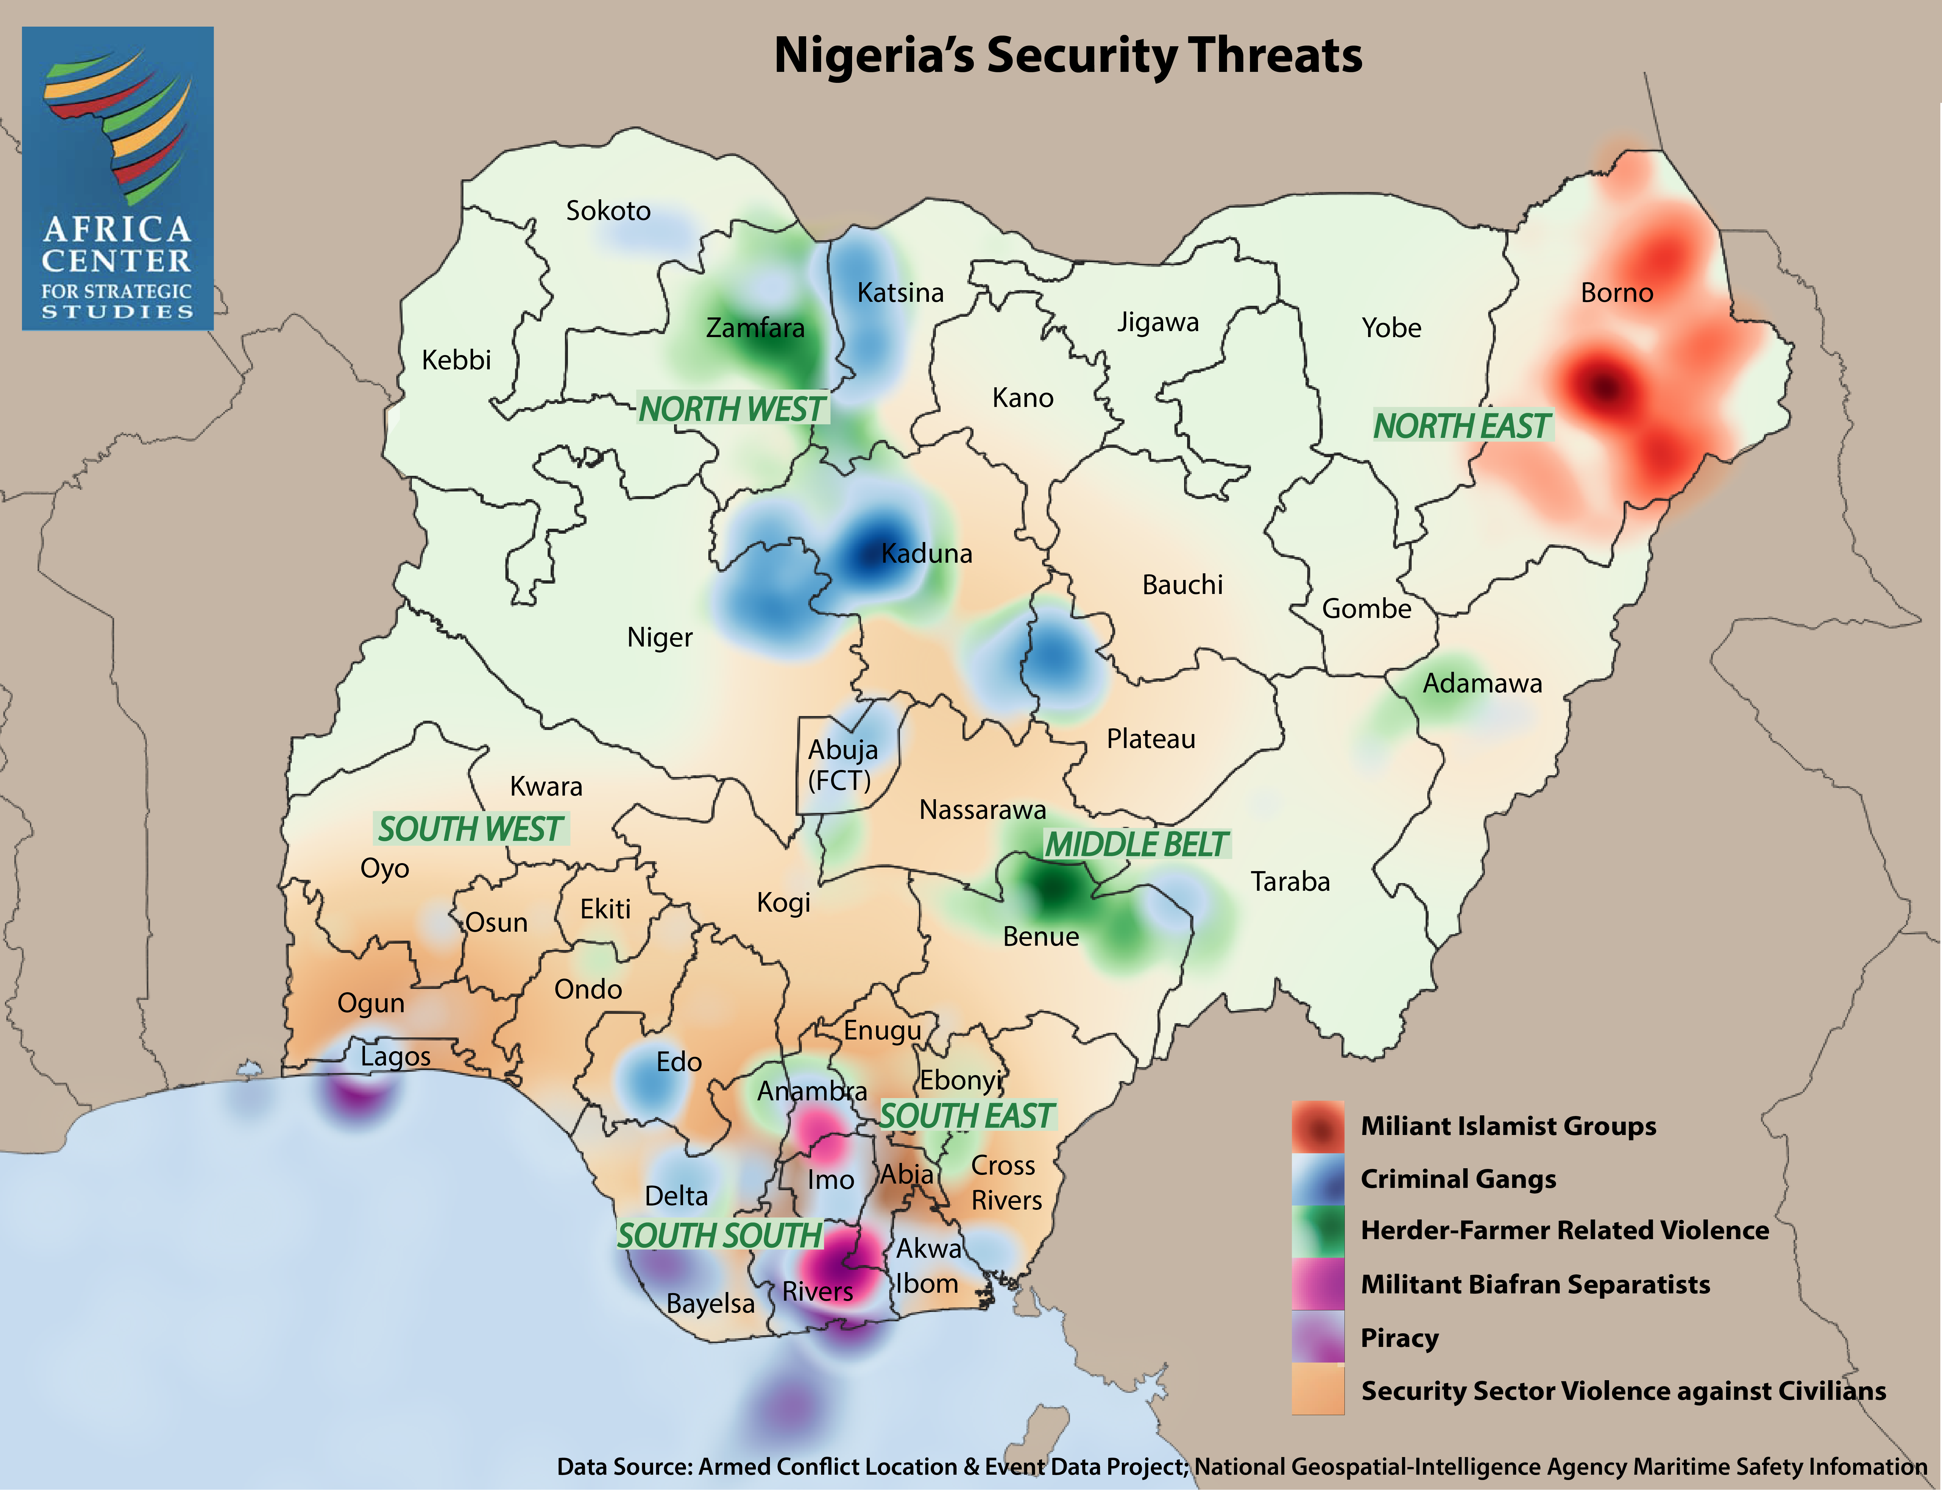
NIGERIA’S SECURITY LANDSCAPE
Multidimensional insecurity
Insurgence – Banditry, etc
Armed Herdsmen
Piracy
Militant Seperatists
Economic Sabotage
Credit: Africa Center for Strategic Studies

Slide 5
NIGERIA’S SECURITY LANDSCAPE
Credit: Africa Center for Strategic Studies

Slide 6
NIGERIA’S SECURITY LANDSCAPE
Credit: Africa Center for Strategic Studies

Slide 7
NIGERIA’S SECURITY LANDSCAPE
Credit: Africa Center for Strategic Studies

Slide 8
NIGERIA’S SECURITY LANDSCAPE
Credit: Africa Center for Strategic Studies

Slide 9
NIGERIA’S SECURITY LANDSCAPE
Credit: Africa Center for Strategic Studies

Slide 10
INNOVATION AND NATIONAL SECURITY
National Identification System
Crime Database/Crime Reporting System
Threat Intelligence
Threat Hunting
Threat Monitoring
Geospatial Analysis
Border protection (UAV, Drone, etc)
Smart Monitoring
Precision Attack
Forensic Science

Slide 11
NATIONAL IDENTITY SYSTEM
Harmonized Database
Biometric verification
Interoperbility issues (Biometric, RFID, etc)
Surveillance purposes
Ethical and Legal Considerations

Slide 12
CRIME DATABASE/CRIME REPORTING SYSTEM
Automated Crime Record Management System
Real time
Harmonized
Background Checks
Stakeholder driven

Slide 13
INTELLIGENCE GATHERING
Planning, Requirement & Direction
Collection
Analysis & Processing
Production
Dissemination
Credit: fas.org

Slide 14
INTELLIGENCE GATHERING
HUMINT
SIGINT
IMINT
OSINT
MASINT

Slide 15
THREAT HUNTING
Active prevention
Threat Hunting as a form of Defence
Threat Hunting Triad – People, Processes, and Technology
SOC-Based Threat Hunting

Slide 16
SECURITY MONITORING
CCTV
Drones/UAVs
IoT
Robotics
Smart monitoring

Slide 17
BORDER PROTECTION
Drones/UAVs
Robotics
Sensors (Optical, Seismic, etc)
Remote Sensing
Surveillance Towers
Mobile Surveillance
Satellite Surveillance
Aerostats
Radio and Cell Data Surveillance
Biometric verification system

Slide 18
FORENSICS
Computer Forensics
Mobile Forensics
Drone Forensics
IoT Forensics
SCADA Forensics
Video Forensics
Crime scene forensics
Medical forensics
Forensic balistics

Slide 19
EMERGING TECHNOLOGIES AND NATIONAL SECURITY
Big Data Analytics
Artificial Intelligence
Internet of Things
Robotics
Block Chain
Forensics

Slide 20
GENERAL RECOMMENDATION
Proactive Planning
Invest in Data Collection and Intelligence gathering
Invest in Technology
Research and Development
Incorporate experts beyond the traditional military cycle
Continuous training
Regional cooporation (porous borders)
Harmonized systems
Shared Intelligence
Smart Incidence Response
An efficient Justice System

Slide 21
THANK YOU

